Slide 1

18ECP110L – Semester Internship
Company : Mu Sigma Inc.
Role : Trainee Decision Scientist(Data Science/Analytics)
Internship Guide:
Dr. S. PRABAKERAN
(Assistant Professor, Department of Networking and Communications)
Presented by:
Abhijeet Senapati -RA1811030010064

Slide 2

Advanced Regression Based Housing Price Prediction Model

Slide 3
Flow of Presentation:
Contents | Slide No.
Abstract | 4
Problem Statement | 5
Tool/Platform | 6
Methodology | 9-8
EDA | 9-15
Feature Engineering | 16-20
Application of Regression Models | 21-26
Conclusion | 27
Future Work | 28

Slide 4
Abstract
1)With the booming civilization and ever-changing market requirements, it is essential to know the market drifts. Today prediction of house prices according to the trends is the principal essence of the study. It is imperative for an individual to understand the business trends so that an individual can prepare his budgetary needs according to his requirements.
2)The foremost intention of this design is to develop a comprehensive model that is advantageous for a business society as well as an individual, which is the main nub of this investigation. This design is intended to assist a client by diminishing his fieldwork moreover extricating his time and money. Models are enlightened in diverse machine learning algorithms such as Linear Regression,Random Forest ,Xgboost algorithm.

Slide 5
Problem Statement
With 79 explanatory variables describing (almost) every aspect of residential homes ,this problem statement from the client,challenges the company to predict the final price of each house.
Execution of the following tasks :
1)Research and document the requirements of the customer.
2)Research and document the necessary metrics to be tracked to solve the problem space.
3)Exploratory Data Analysis
4)Creative feature engineering
5)Feature Selection
6)Advanced regression techniques like random forest ,lasso regression and gradient boosting

Slide 6


Tool /Platform
Anaconda ,Jupyter Notebook,Pyspark,Microsoft Excel

Slide 7
Methodology
We have undertaken different data mining and machine learning concepts. The following steps represents step-wise tasks that need to be completed:
1)Data collection
2)Data preprocessing
3)Handling missing values
4)Handling Outliers
5)Getting dummy categorical features
6)Application of Algorithms

Slide 8
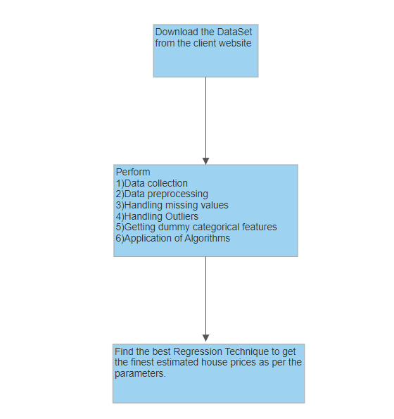

Slide 9
EXPLORATORY DATA ANALYSIS
In statistics, exploratory data analysis is an approach of analyzing data sets to summarize their main characteristics, often using statistical graphics and other data visualization methods.
EDA is for seeing what the data can tell us beyond the formal modeling.
Following things are part of EDA :
Percentage of missing values in each and every feature.
Skewness
Log Transformation
Handling Outliers

Slide 10
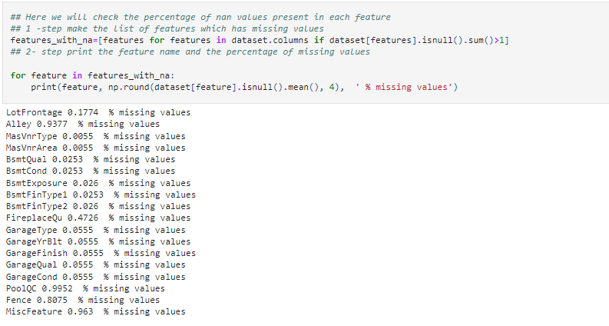
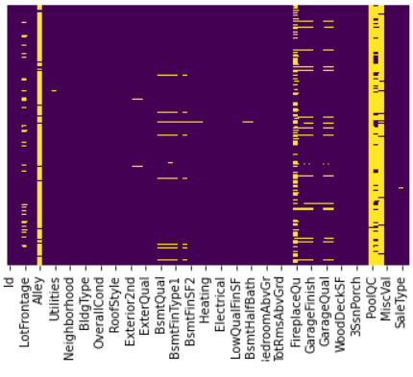
1. Percentage of missing values
Fig :% Missing Values
Fig: SNS Heatplot

Slide 11
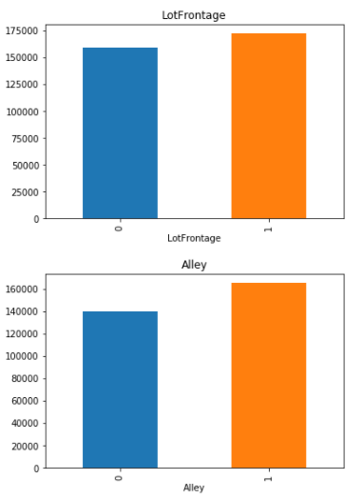
Since there are many missing values a relationship between missing values and sales prices has been ploted.
Present Features
Missing Features
Note: Here with the relation between the missing values and the dependent variable is clearly visible.So We need to replace these nan values with something meaningful which we will do in the Feature Engineering.
Fig : Sales Price Vs Features

Slide 12
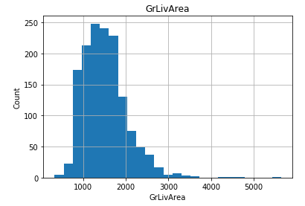
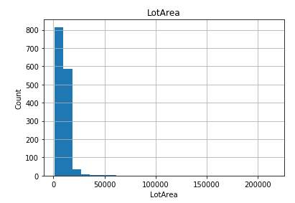
2. Skewness :
It is a measure of the asymmetry of the probability distribution of a real-valued random feature about its mean.
The data is not normally distributed or skewed ,thus we had to perform LogTransforation.
Fig : Counts Vs Sales Price

Slide 13
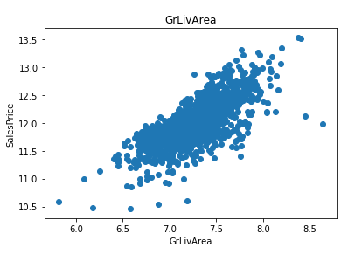
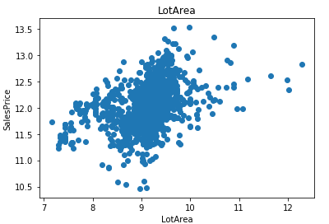
3. Log Transformation
Makes the data as “normal” as possible so that the statistical analysis results from this data become more valid.
After applying Log - Normal Distribution ,we get a positive correlation value.
Fig :SalesPrice Vs Count

Slide 14
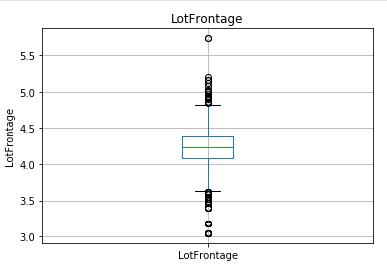
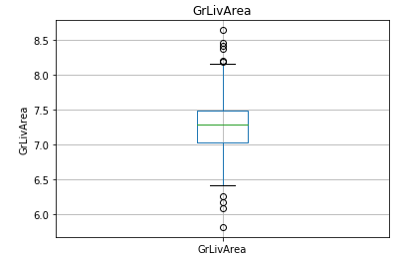
4. Handling Outliers :
In the dataset, there are many homes with zero value for LotFrontage, indicating that they don’t have a front space.We’ll transform outliers that can affect a regression model.So, we remove or replace those observations from our data.
Fig : Rpresents Zeroth Percentile,Fiftyth Percentile ,Hundreth Percentile Values

Slide 15
Feature Engineering :
Feature engineering is the process of selecting, manipulating, and transforming raw data into features that can be used in supervised learning. In order to make machine learning work well on new tasks, it might be necessary to design and train better features.
We will be performing all the below steps in Feature Engineering
Manipulate Missing values
Find categorical variables: remove rare labels
Standarise the values of the variables

Slide 16
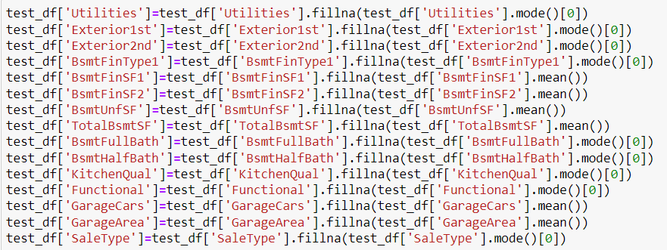
1.Missing NaN values
Replacing the NaN values with median for numerical features ,since there are outliers present as well.
Replacing the NaN values with mode for categorical features.

Slide 17
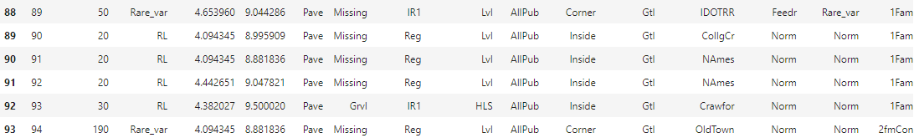
2.Handling Rare Categorical Features
When working with categorical features, a common approach is to use one-hot-encoding and create a binary feature for each possible category.
One hot encoding is the most widespread approach, and it works very well unless your categorical variable takes on a large number of values.
Suppose if any category in a particular feature like MsZoning is present and has less than one percent we can skip that particular category within the feature since it will not provide that much weight oin the dataset.

Slide 18
3.Feature Selection
Is a technique to standardize the independent features present in the data in a fixed range.
It is performed during the data pre-processing to handle highly varying magnitudes or values or units. If feature scaling is not done, then a machine learning algorithm tends to weigh greater values, higher and consider smaller values as the lower values, regardless of the unit of the values.
MinMax scaler has been used in this particular dataset.The values have been converted between the range of zeros and ones.

Slide 19
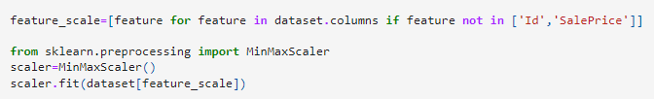
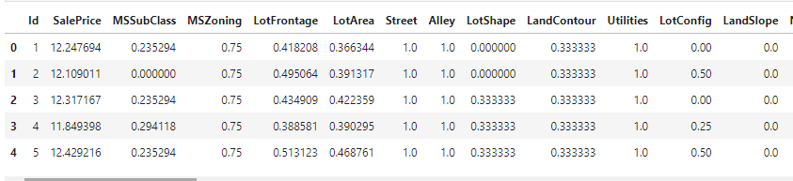
Fig : MinMax Scaler

Slide 20

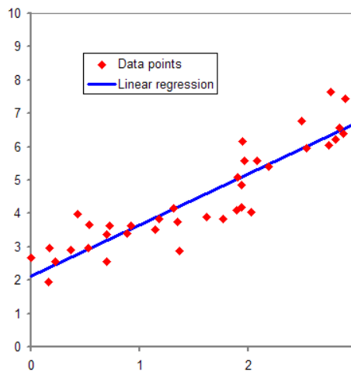
APPLICATION OF ML MODELS
Lasso Regression
XGBoost
Random Forest
Linear Regression

Slide 21
Linear Regression :
1)It is an algorithm of supervised machine learning in which the predicted output is continuous with having a constant slope. It is used to predict the values in a continuous range.
2)The goal is prediction, forecasting, or error reduction, linear regression can be used to fit a predictive model to an observed data set of values of the response and explanatory variables.
3)The Best-Fit line determines ,how accurately the model will perform.
4)In our model we have received an accuracy of 85.5 % for Linear Regression Model.

Slide 22
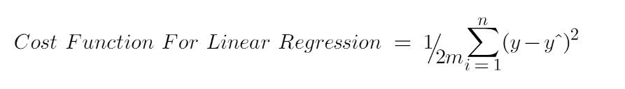
Best Fit Line
Features

Slide 23
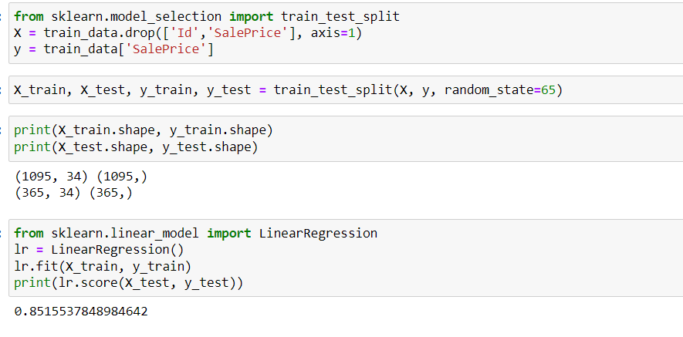
Fig : Linear Regression

Slide 24
Lasso Regression
1)It is a type of linear regression that uses shrinkage. Shrinkage is where data values are shrunk towards a central point, like the mean.
2)Alpha, the coefficient is used to penalize weights.The bigger the value of Alpha, less number of features will be selected.(here Alpha =0.005)
3)Since on training data ,we found deviations ,hence we went for Lasso regression to overcome overfitting.
4)The model improved the accuracy upto 92.27 %

Slide 25

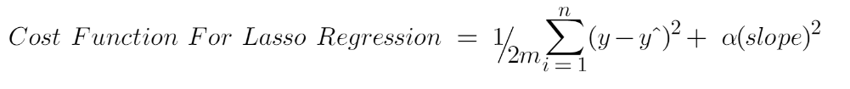
Slope(α)

Slide 26
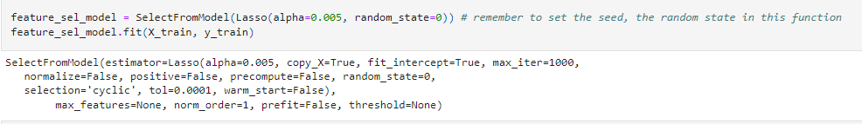
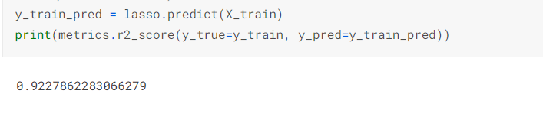
Fig : Lasso Regression

Slide 27
Conclusion
1)Various datasets were collected from the client websites.
2)Exploratory data analysis ,feature engineering ,feature selection has been performed.
3)Implementation of Supervised Machine Learning Models ,like Linear &Lasso Regression Model has been performed.

Slide 28
Future Work
1)The model can be further modified by training it with more datasets. This will improve the accuracy results for the client with little or no variation of the estimated house prices.
2)Advanced regression techniques like Random Forest ,Xgboost algorithm are yet to be performed.

Slide 29
THANK YOU

